Slide 1
Java Profiling Tools
YourKit , JProfiler

Slide 2


YourKit

Slide 3

YourKit
Company
First Version released on August 1, 2003.
Version
Current version 2013
Cost
Ranges from $500(single license) to $6,200(floating license for 5 machines)
Website
http://www.yourkit.com/download/

Slide 4
Basic Features
Yourkit has tonnes of features, but I will concentrate on the features I have been concentrating on.
IDE Integration
CPU Profiling

Slide 5
IDE Integration
Supports wide variety of IDE Integrations.
IDEs of our Interest are:
Eclipse(STS)
IntelliJ
NetBeans

Slide 6
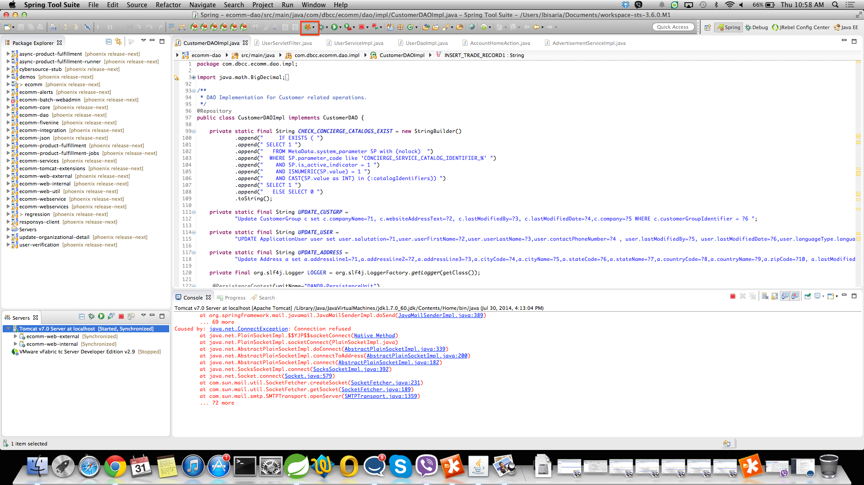
IDE Integration

Slide 7
CPU Profiling
CPU telemetry
Sampling and tracing
Java EE high-level statistics
CPU views: hot spots, method call tree and method list
"Callees list" view
CPU usage estimation
Ability to compare CPU snapshots

Slide 8
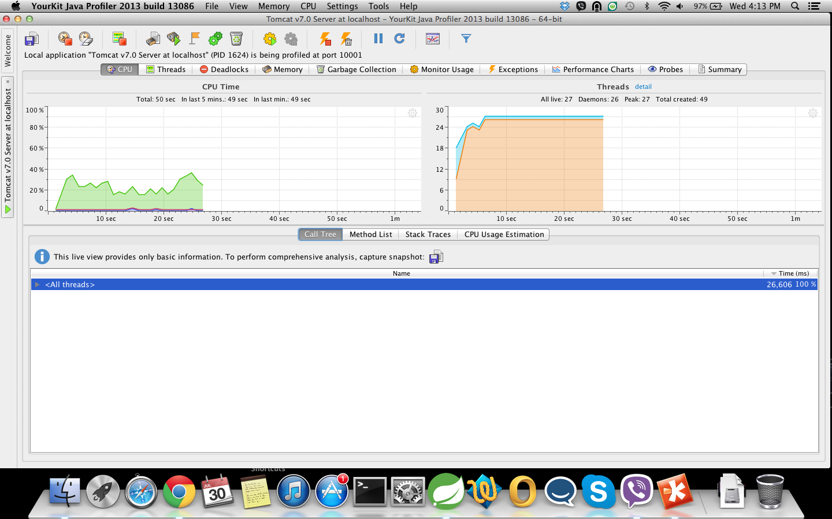
CPU Profiling(contd.)
CPU Telemetry

Slide 9
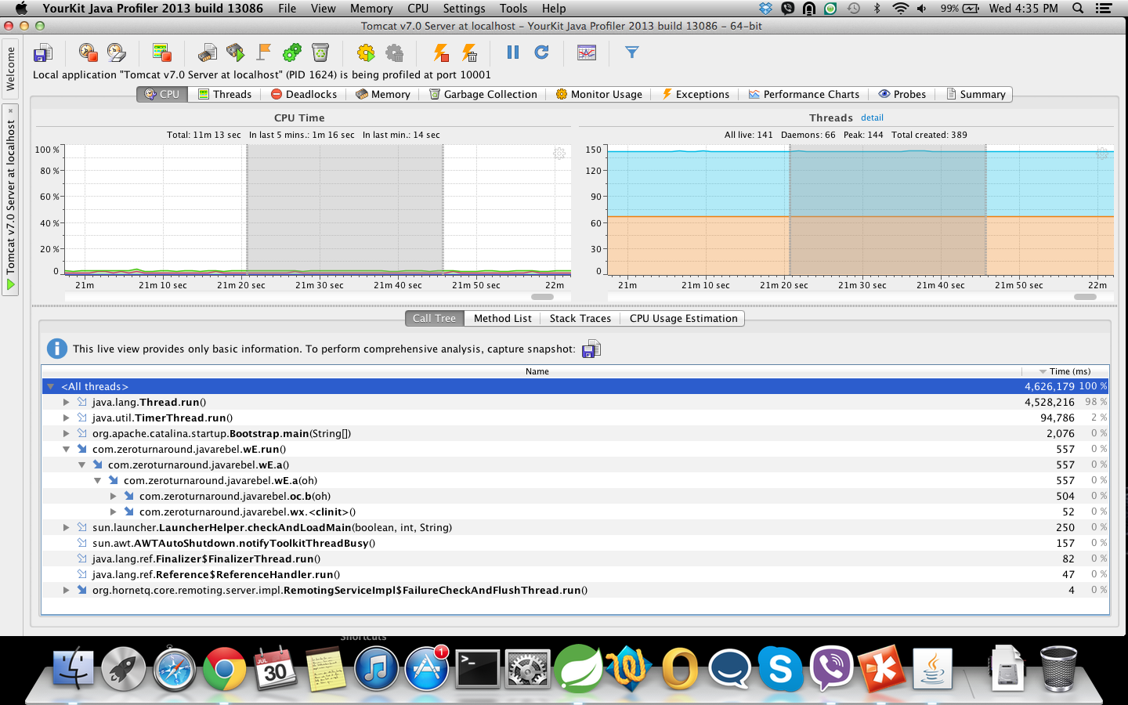
CPU Telemetry
Call tree

Slide 10
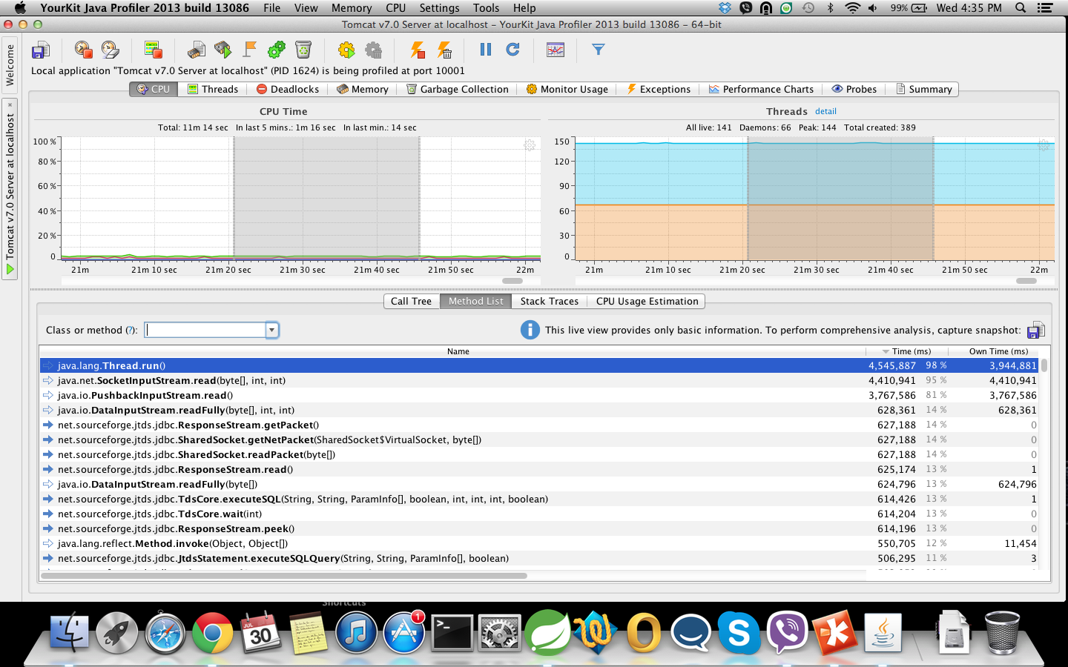
CPU Telemetry(contd.)
Method List

Slide 11
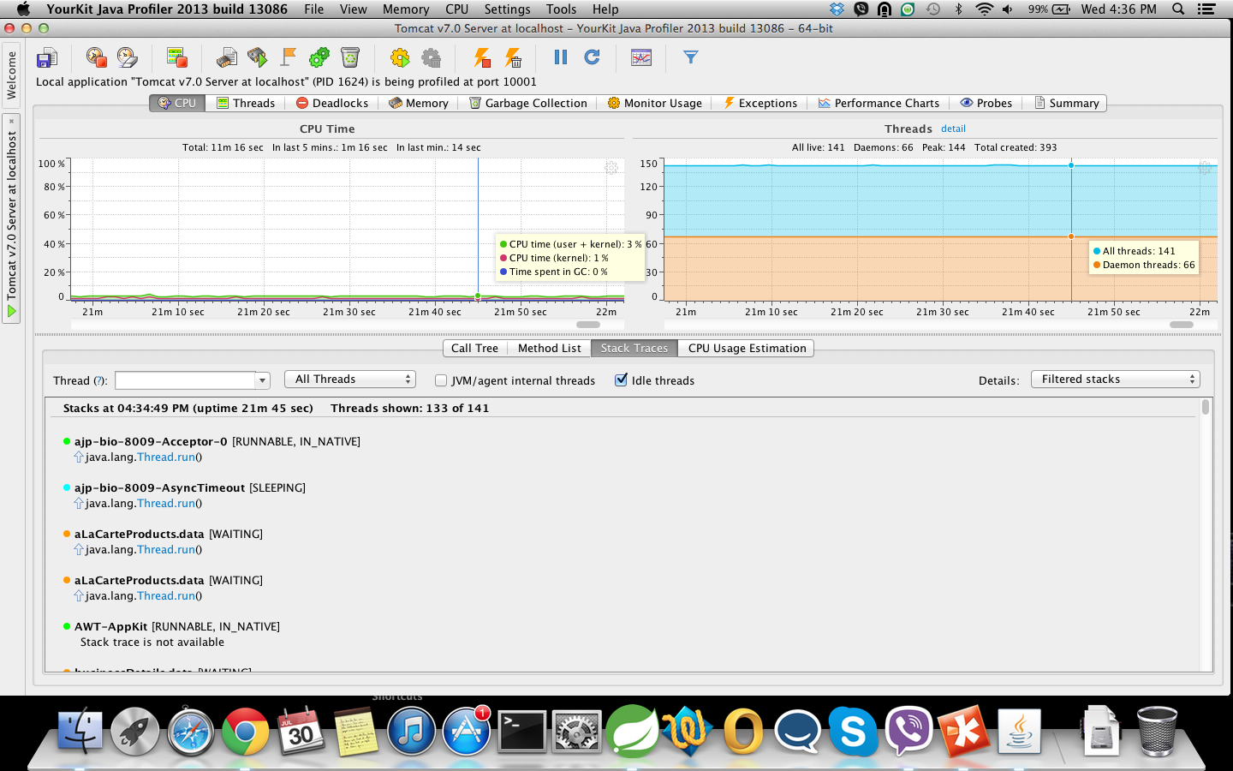
CPU Telemetry(contd.)
Stack Traces

Slide 12
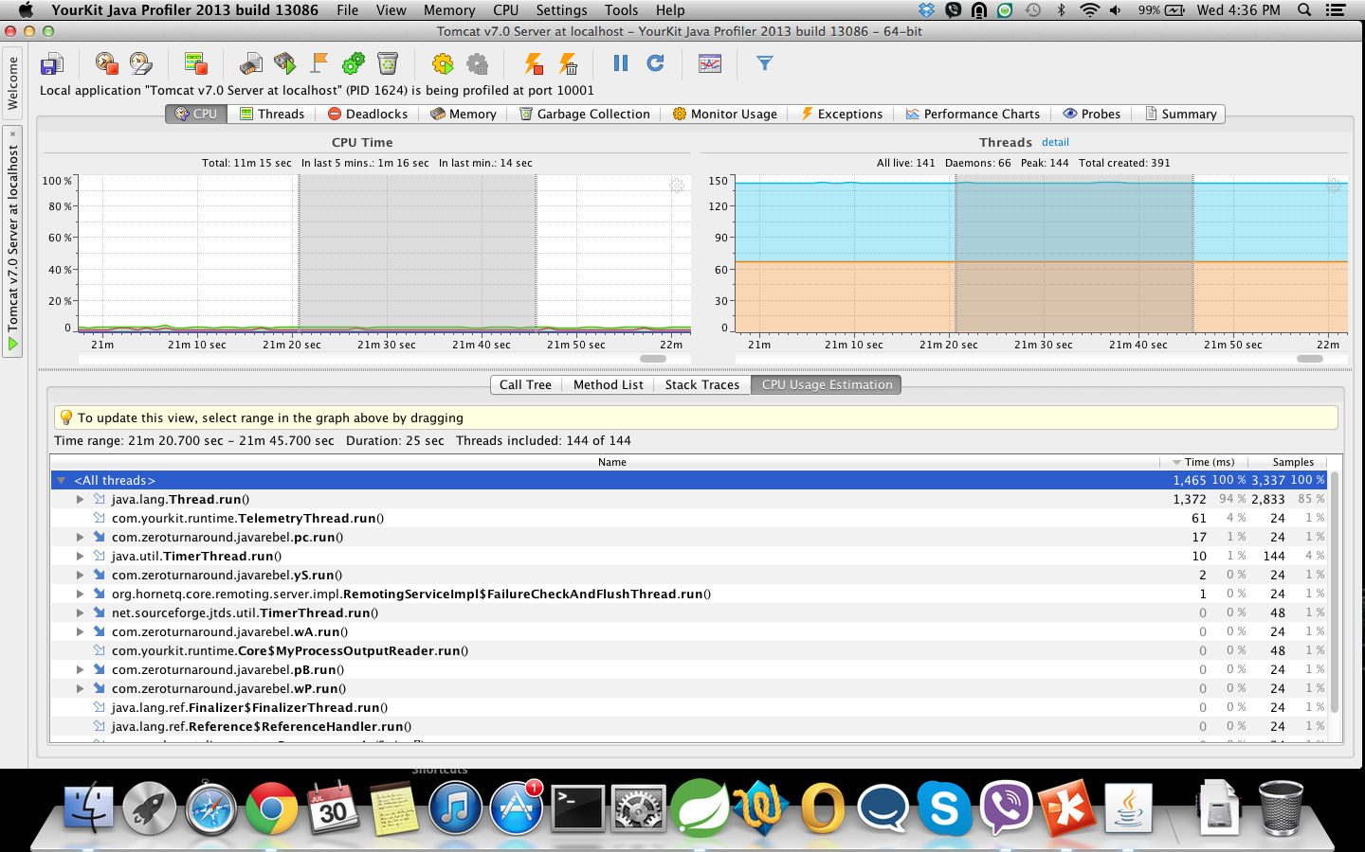
CPU Telemetry(contd.)
CPU Usage Estimations

Slide 13
Sampling and Tracing
Two available measurement modes:
Sampling
Tracing.
When sampling is used, the profiler periodically stacks of running threads to estimate the slowest part of the code.
Sampling is typically the best option when your goal is to locate and discover performance bottlenecks.With sampling, the profiler adds virtually no overhead to the profiled application.
When tracing is used, the profiler instruments the bytecode of the profiled application for recording thread CPU timespent inside each profiled method.Both times and invocation counts are available.

Slide 14
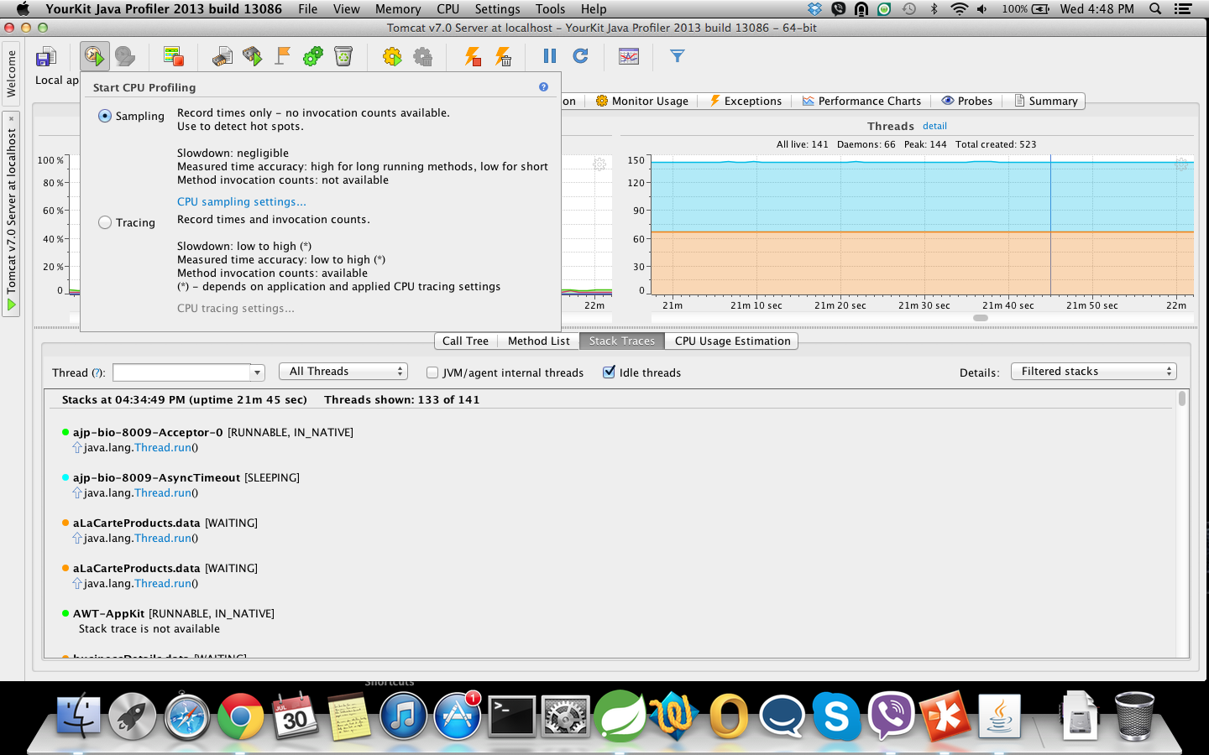
Sampling and Tracing(contd.)

Slide 15
Profiling Phoenix with YOURKIT
Most exciting feature for getting all the details of the flow.
Follow simple steps:
Click on Stop CPU Profiling Icon(So that everything is reset).
Click on Start CPU Profiling Icon.
Perform the steps of the flow in your browser.
Click on the ‘Record Snapshots’ icon.
The snapshot is recorded.
Examine the snapshots for all the information for the flow.
Easy as you like :)

Slide 16
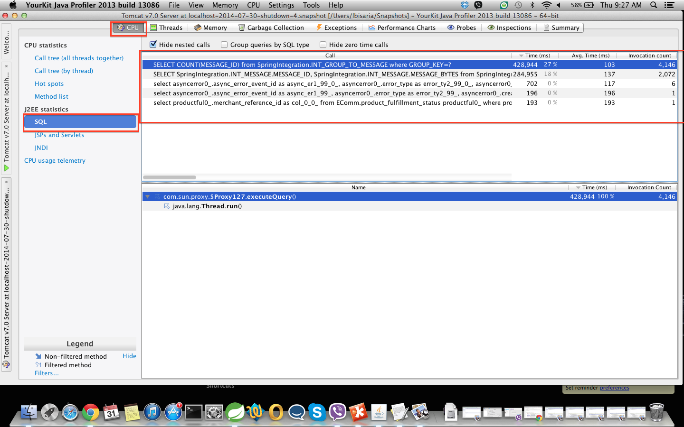
Profiling using Snapshots

Slide 17
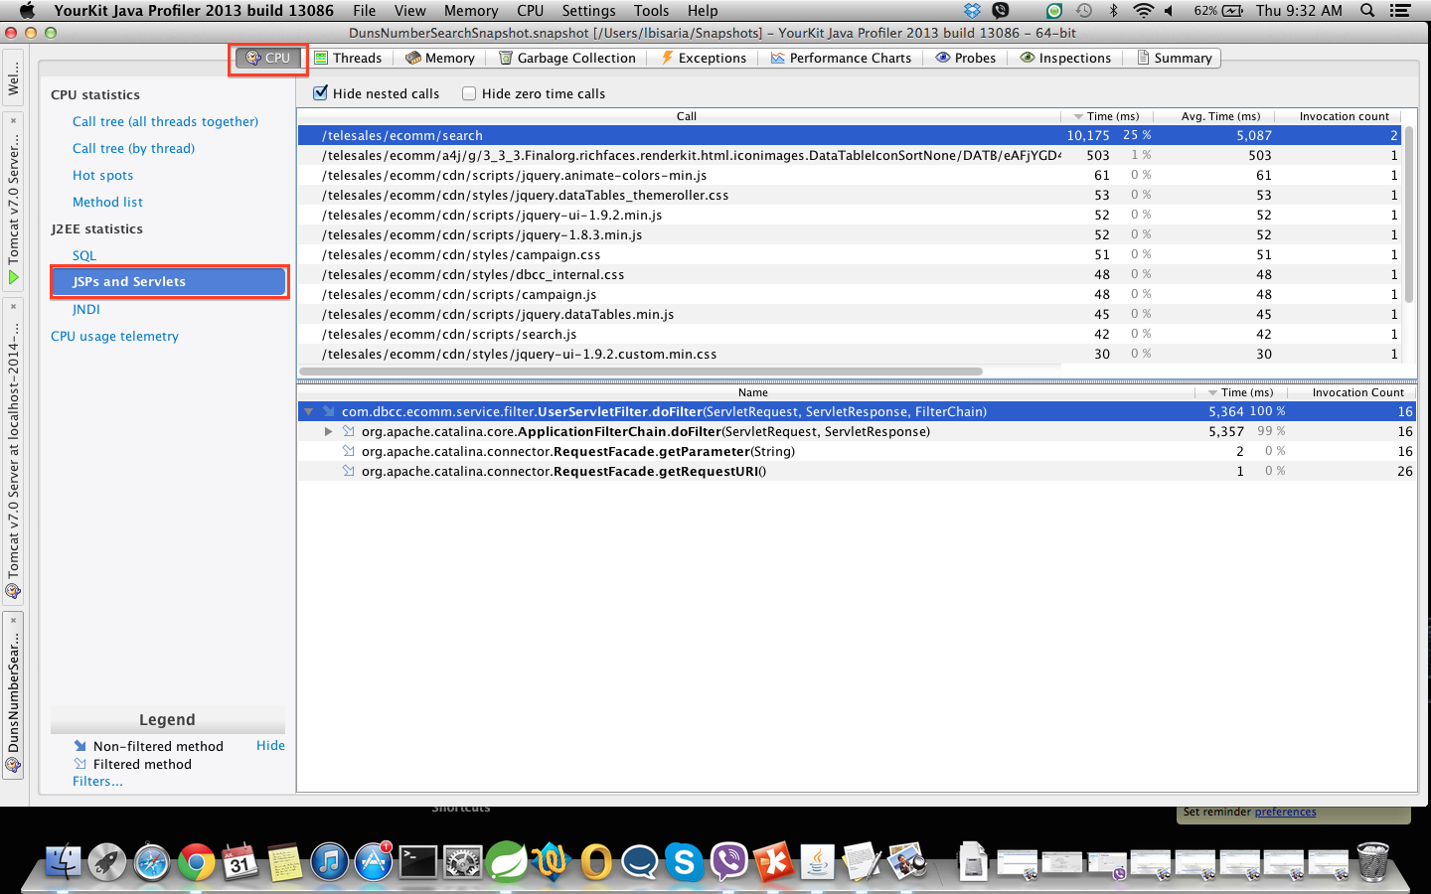
Profiling using Snapshots(contd.)

Slide 18
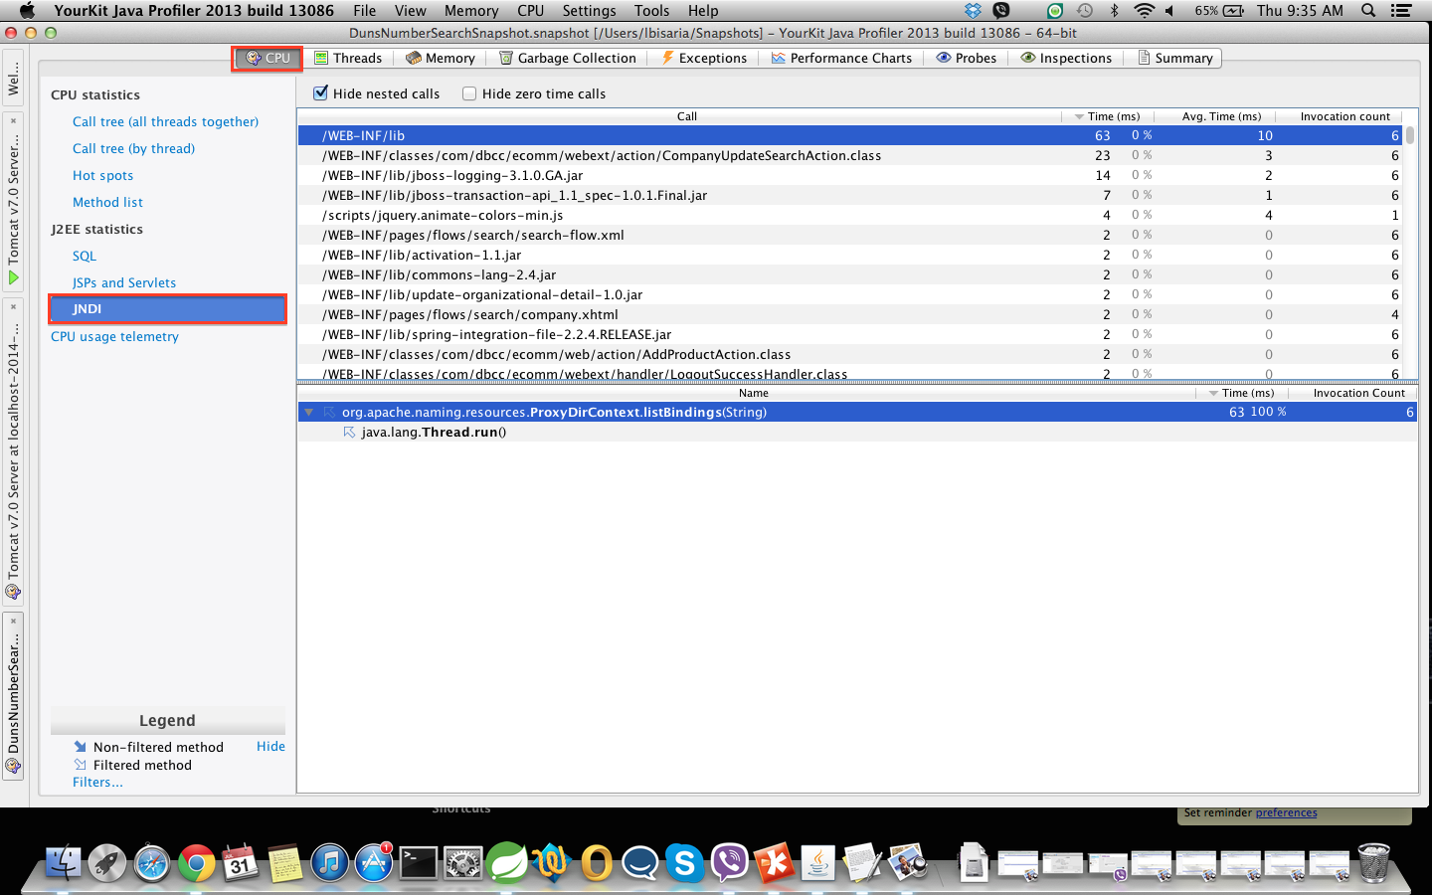
Profiling using Snapshots(contd.)

Slide 19
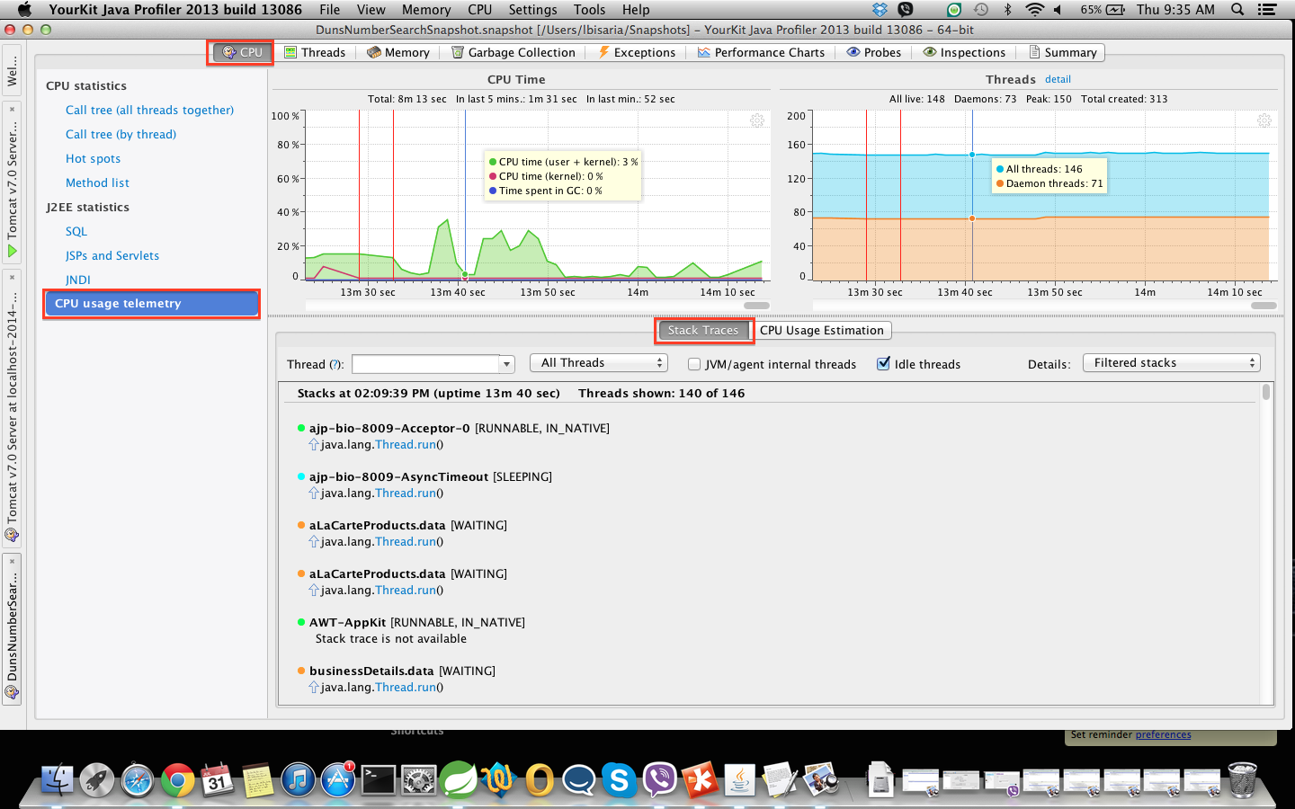
Profiling using Snapshots(contd.)

Slide 20
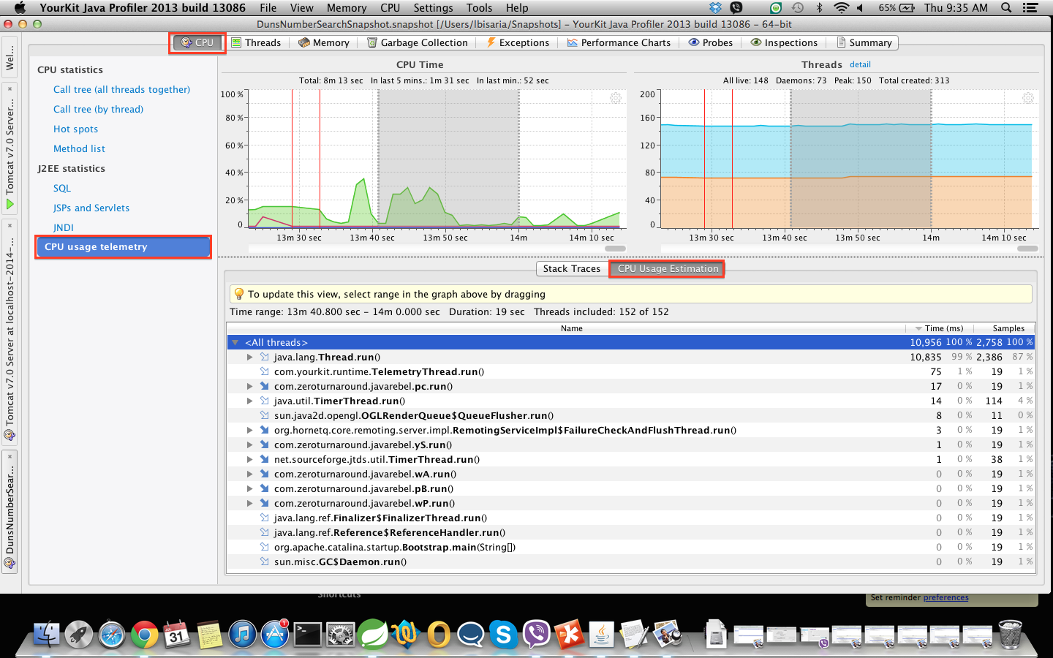
Profiling using Snapshots(contd.)

Slide 21
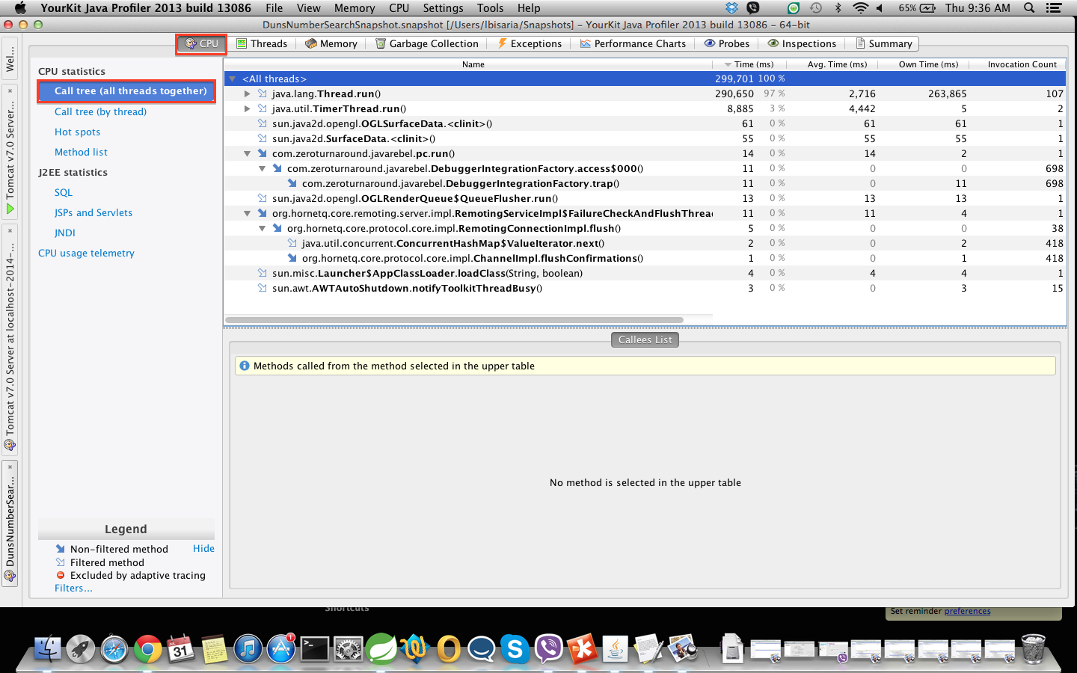
Profiling using Snapshots(contd.)

Slide 22
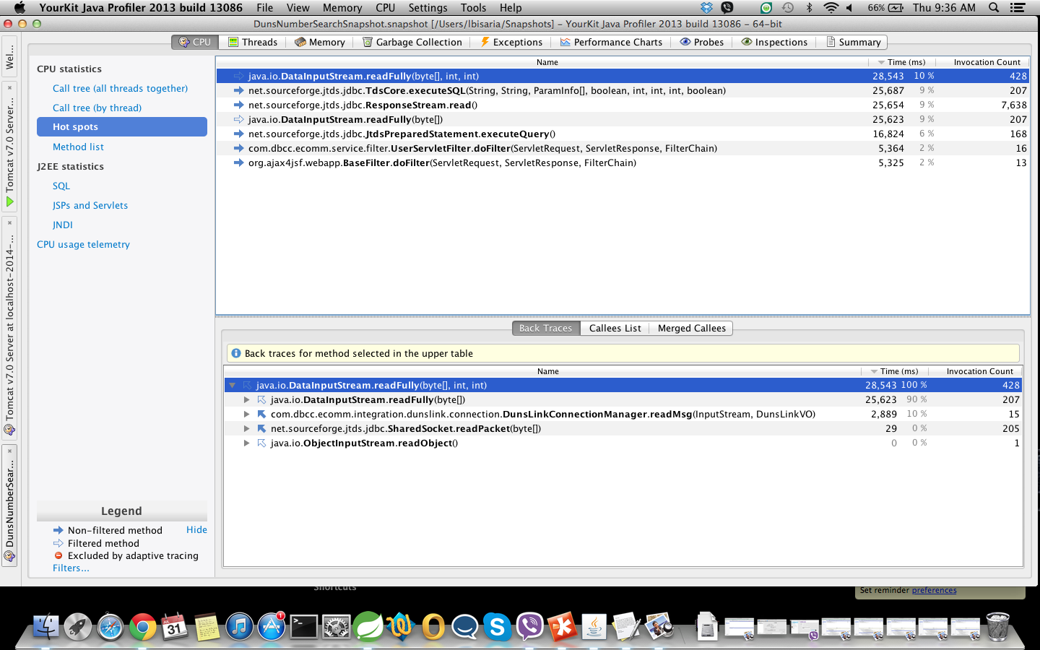
Profiling using Snapshots(contd.)

Slide 23
Profiling using Snapshots(contd.)

Slide 24
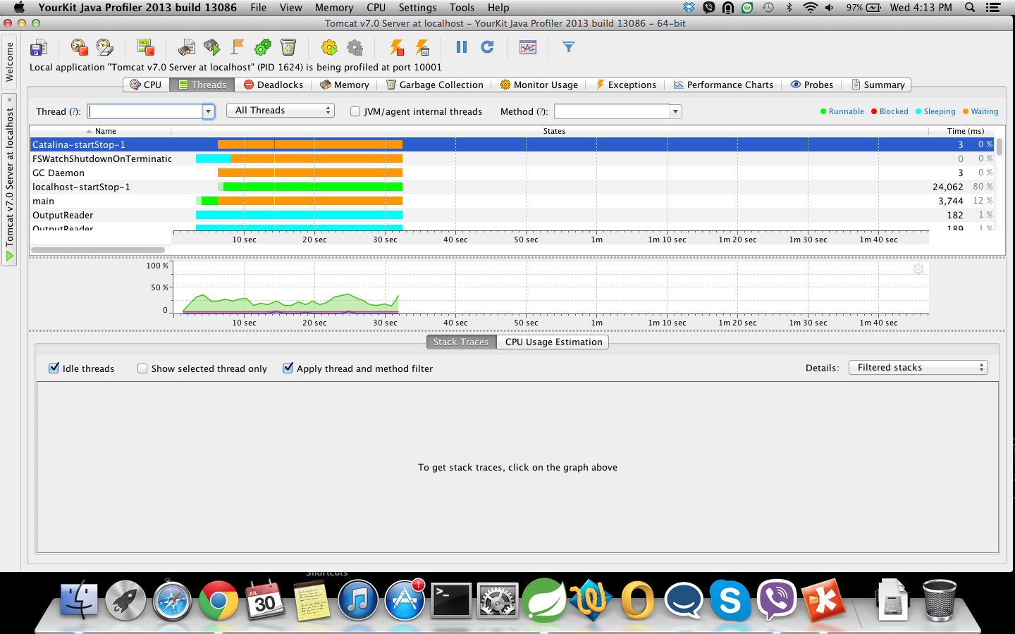
Profiling(contd.)
Threads Profiling

Slide 25
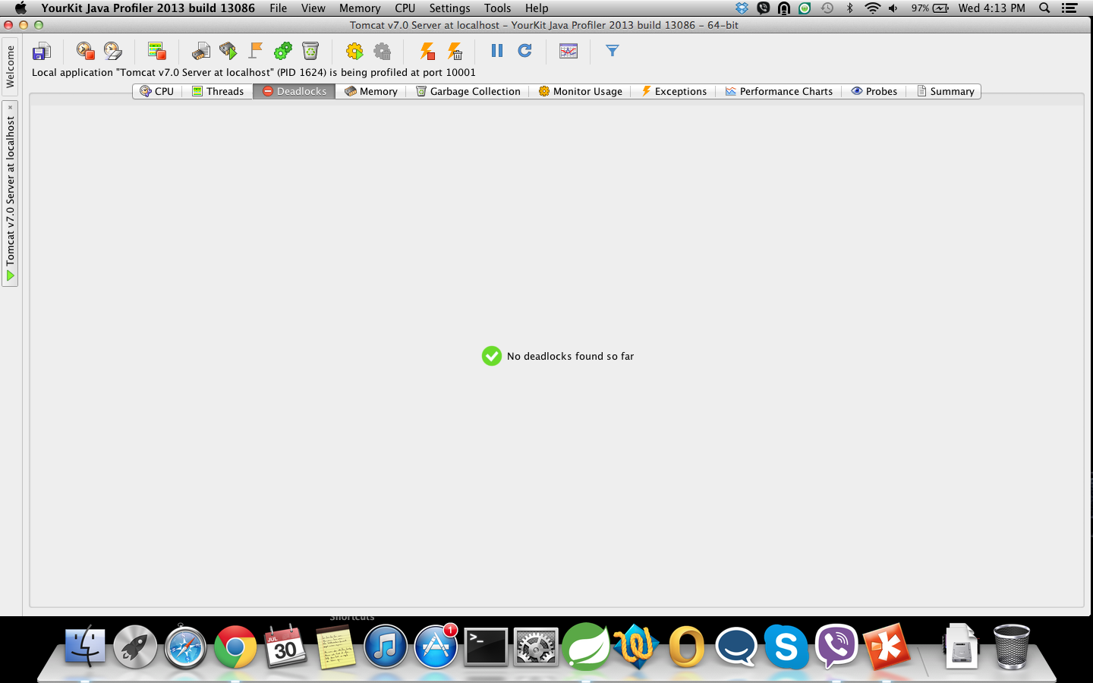
Profiling(contd.)
Deadlock

Slide 26
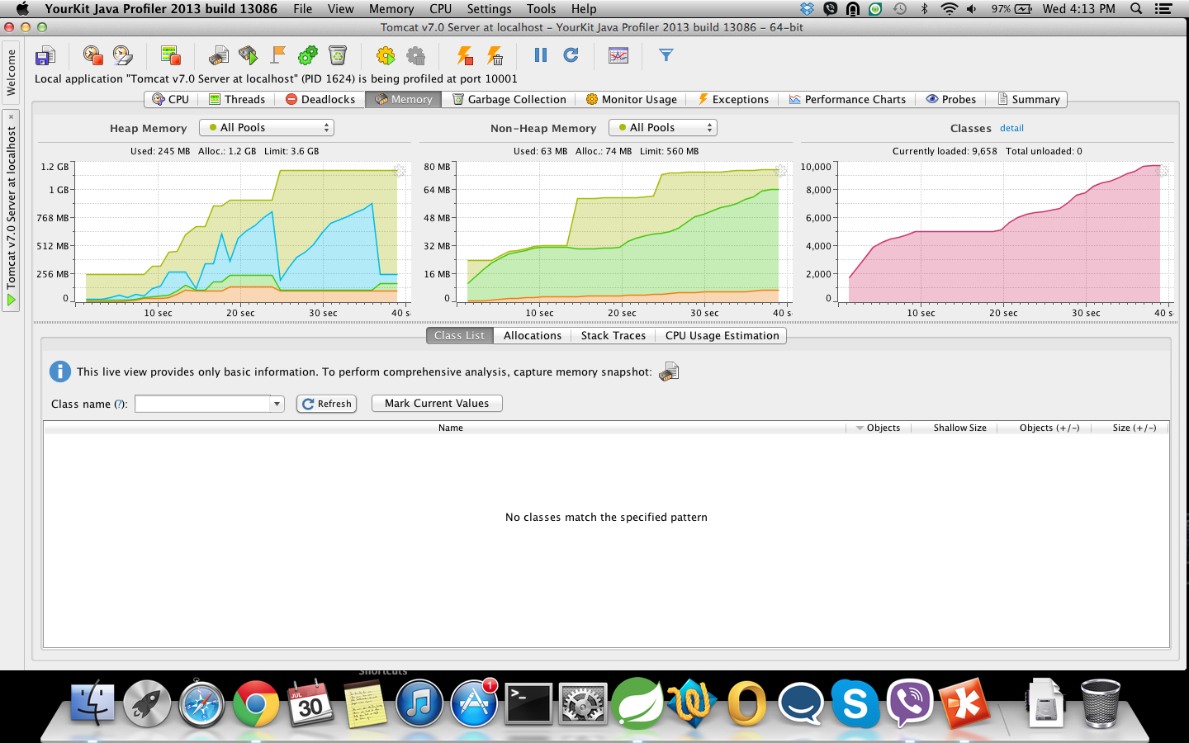
Profiling(contd.)
Memory Profiling

Slide 27
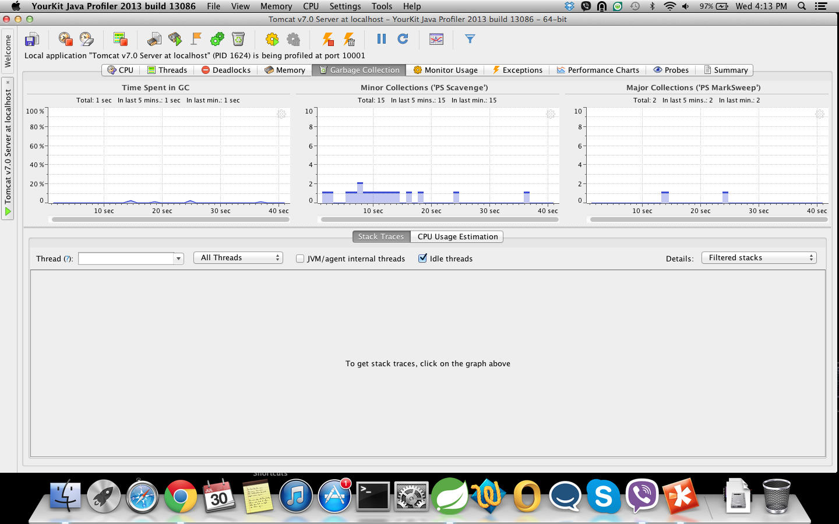
Profiling(contd.)
Garbage Collection Profiling

Slide 28
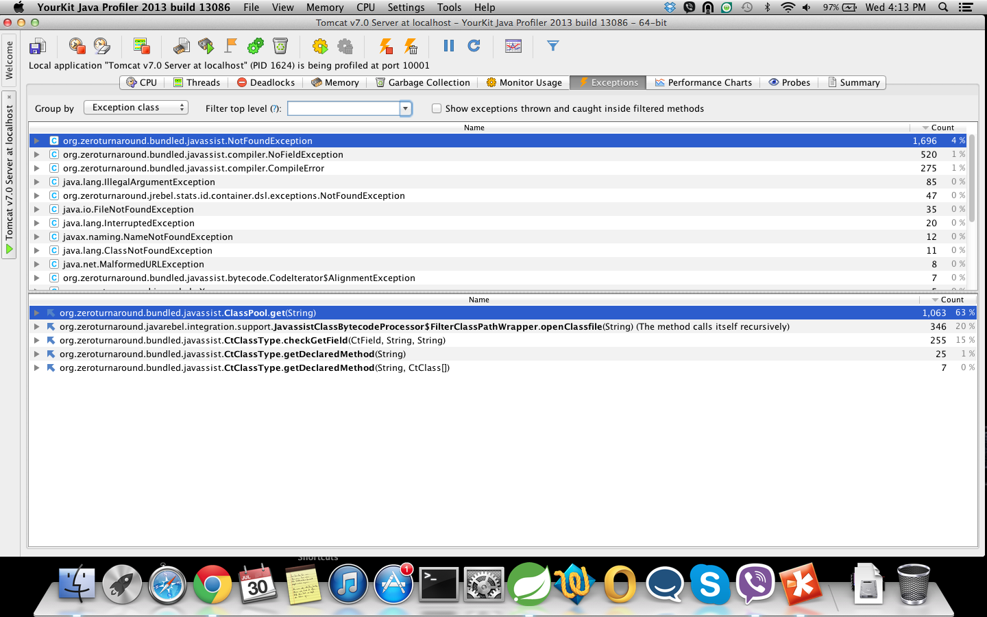
Profiling(contd.)
Exceptions

Slide 29
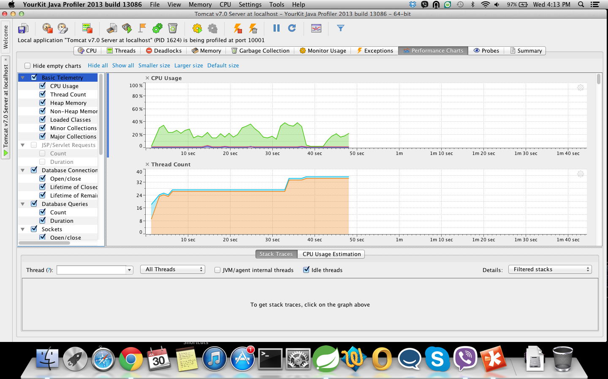
Profiling(contd.)
Performance charts

Slide 30
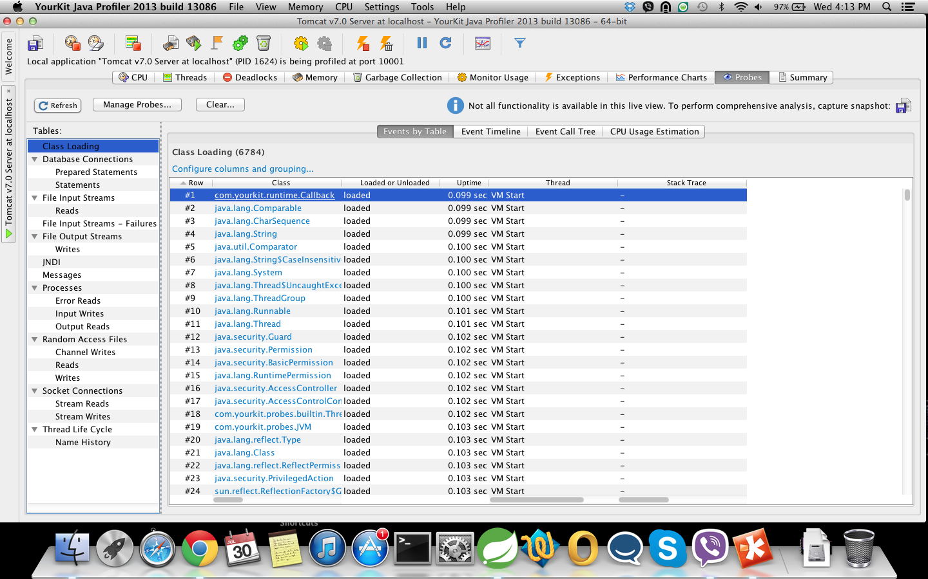
Profiling(contd.)
Probes

Slide 31
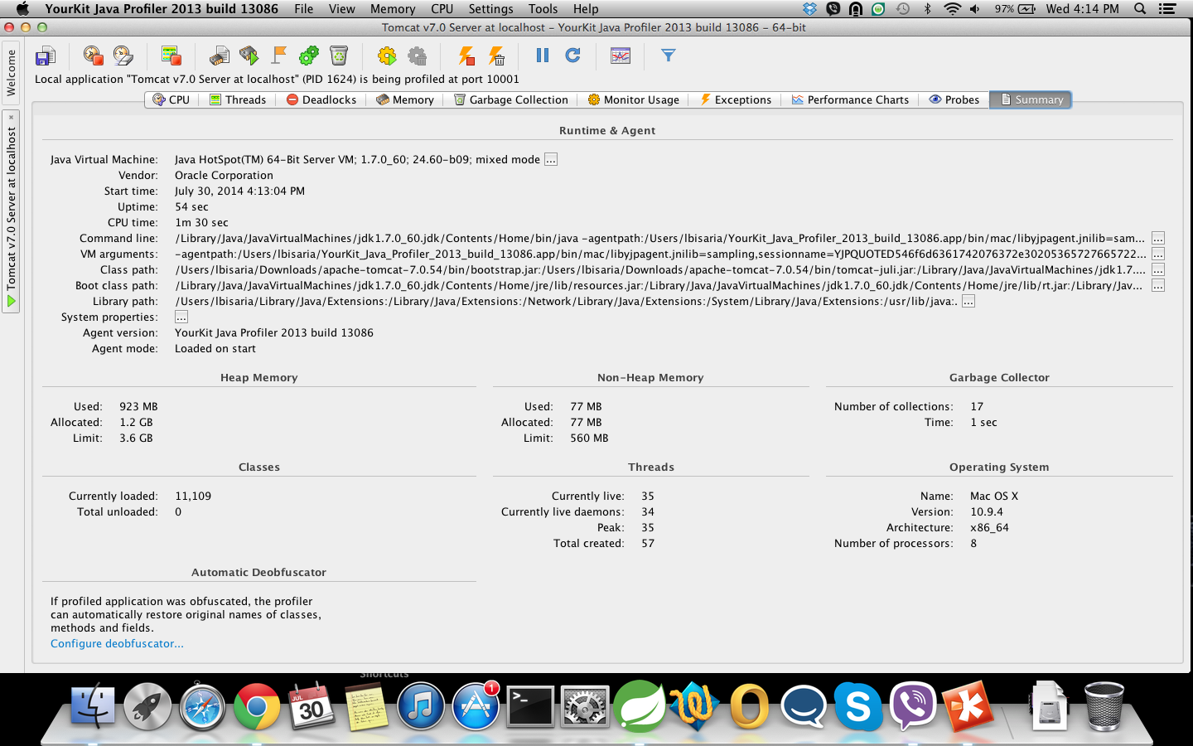
Profiling(contd.)
Summary of the Profiling

Slide 32

JProfiler

Slide 33
JProfiler
Company
First version released in 2002.
Version
Current version 8.0
Cost
$500(single license) to $2000(single floating license)
Website
http://www.ej-technologies.com/download/jprofiler/files

Slide 34
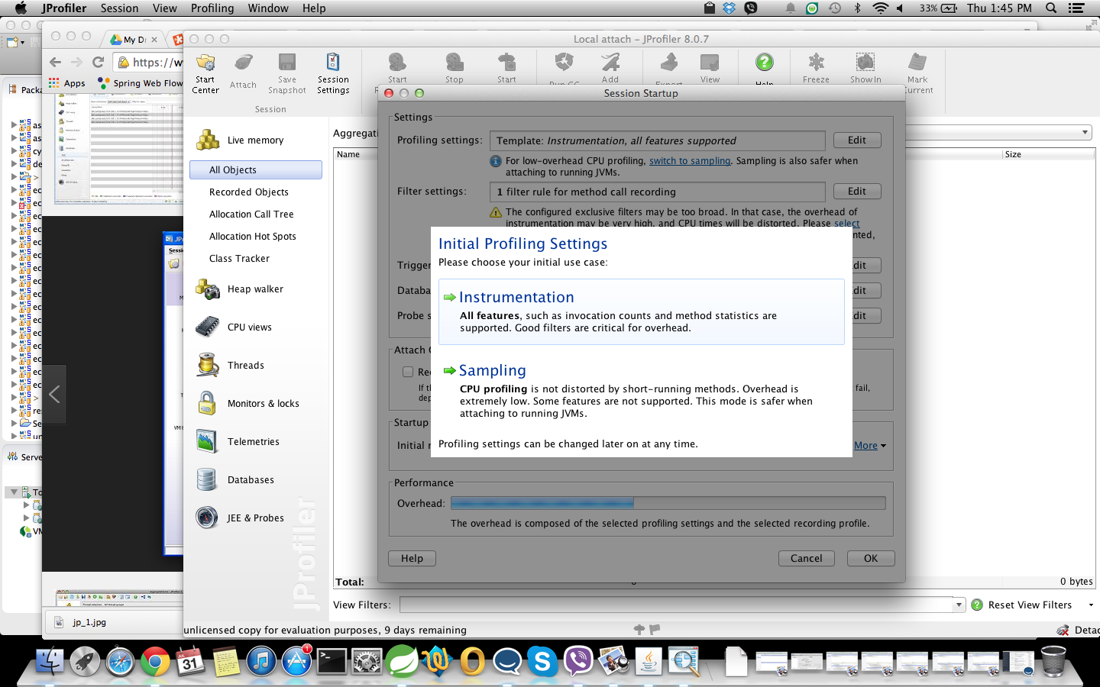
JProfiling-Sampling

Slide 35
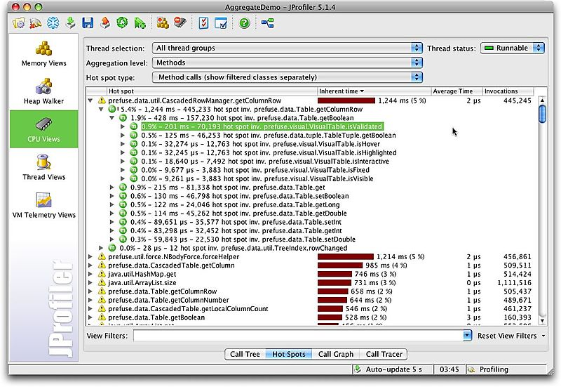
JProfiling-CPU

Slide 36
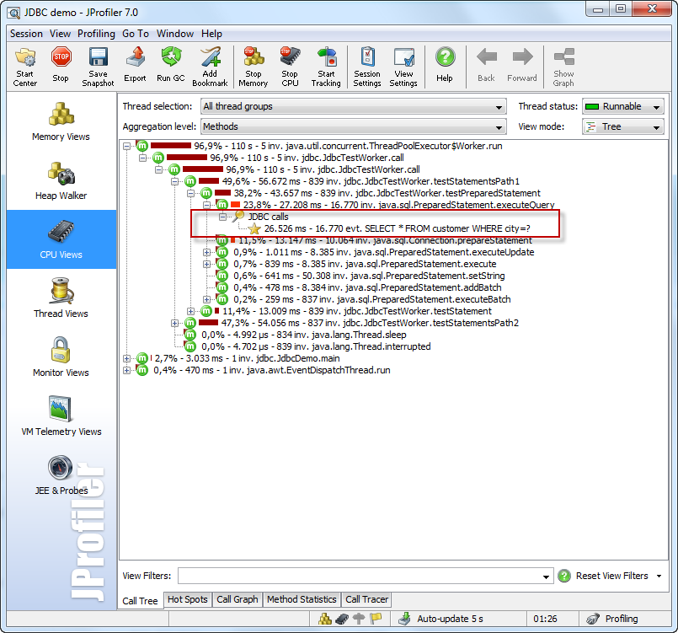
JProfiling-CPU

Slide 37
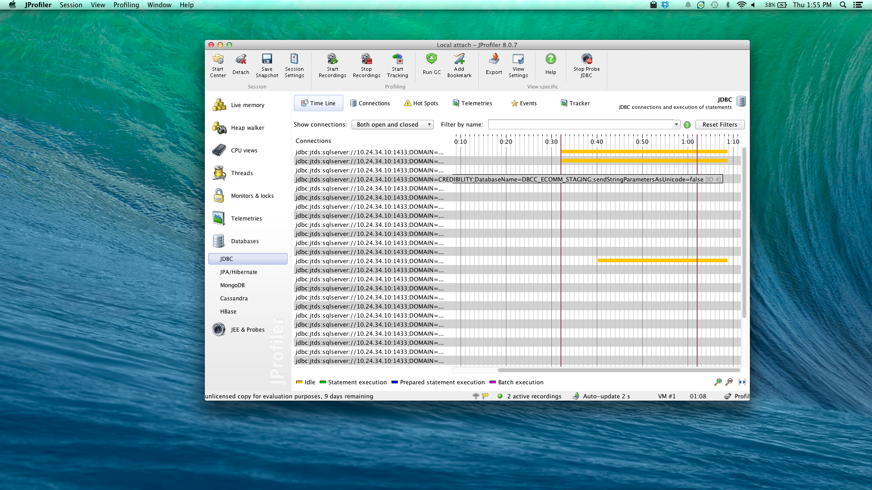
JProfiling-SQL

Slide 38
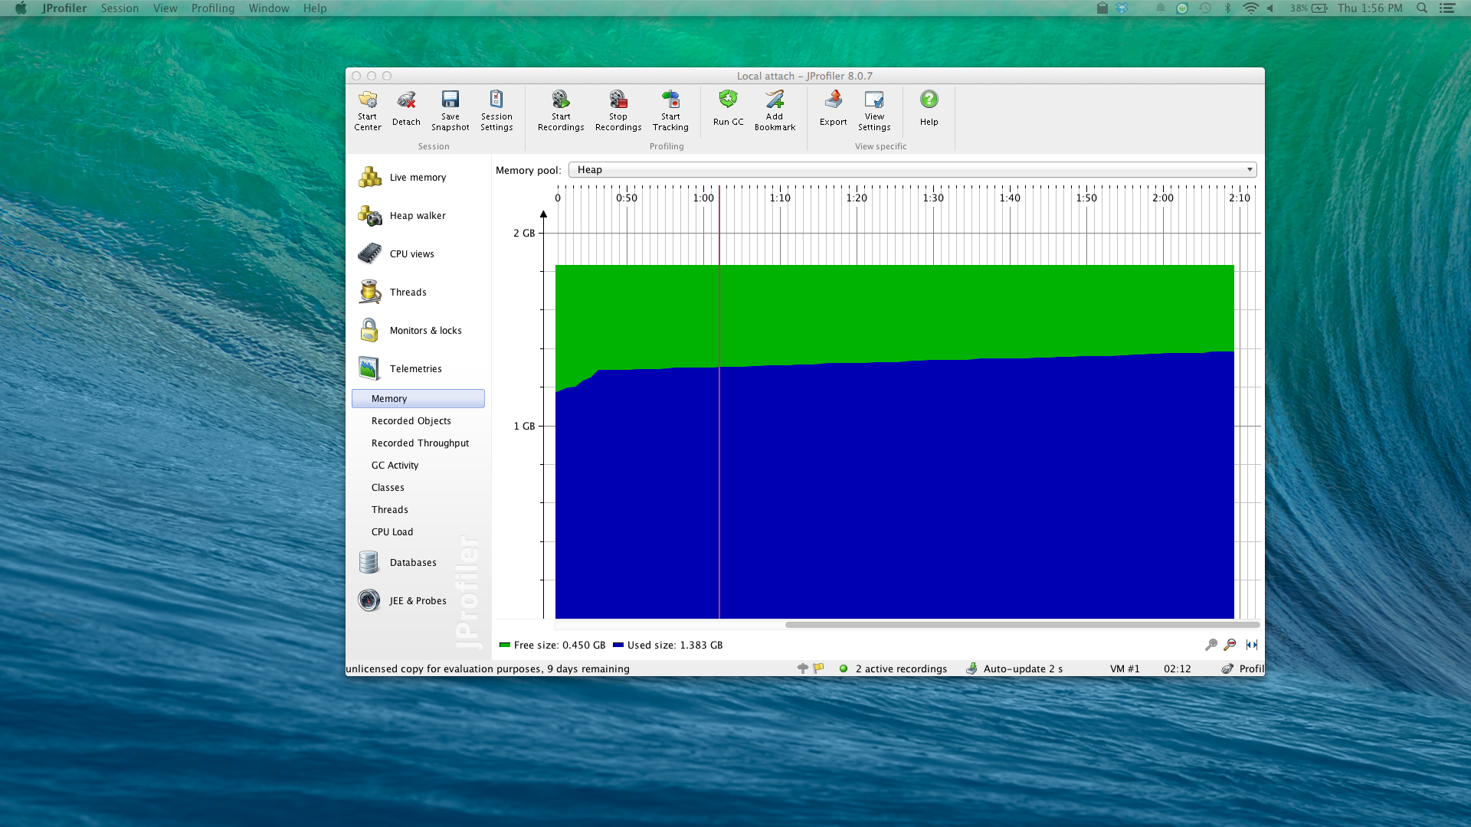
JProfiling-Memory

Slide 39
Thanks!!

